Slide 1
Big data in Biogeography and Conservation
Glenda Mendieta-Leiva
Summer semester 2020
Some material taken from:
http://alexanderzizka.net

Slide 2

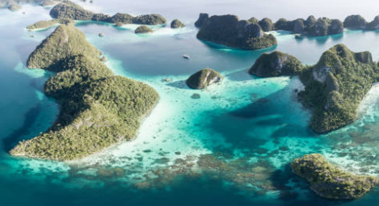

Big data
Biogeography
Conservation
© Adobe 2020
© Adobe 2020
© Adobe 2020

Slide 3
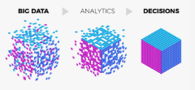
Big data
“Use of the term ‘big data’ implies an approach that includes capacity to aggregate, search, cross-reference, and mine large volumes of data to generate new understanding that can inform decision-making about emergent properties of complex systems.”
LaDeau et al. (2016)

Slide 4
Biogeography
“The science that attempts to document and understand spatial patterns of biological diversity.”
Lomolino et al. (2006)

Slide 5
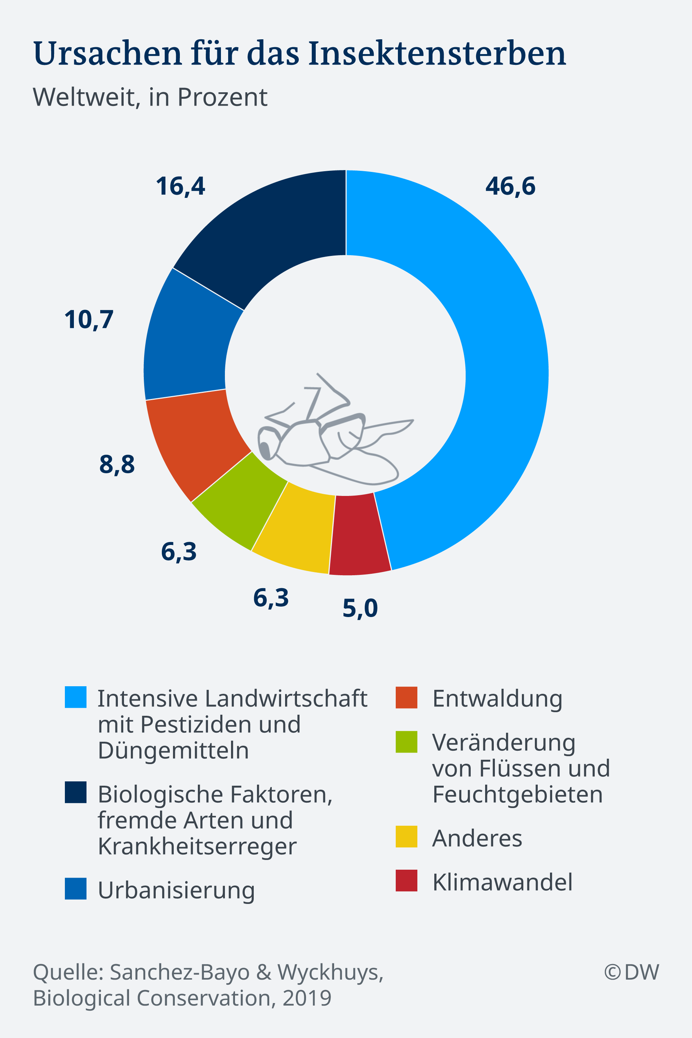
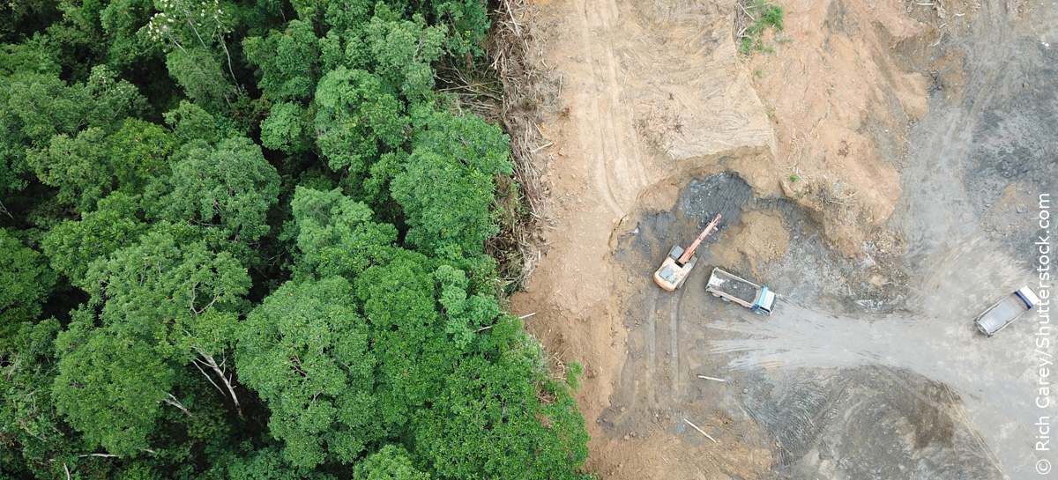
Conservation
“consumptive and nonconsumptive use without complete destruction/conversion.”
Redford & Richter (2001)

Slide 6
Understanding biodiversity
genetic diversity
("How diverse is the genetic material?")
organismic diversity
("How many species are there?")
ecological or functional diversity
("How diverse are forms and ecological roles?“
…”changes in abundance and distribution over time and space within and among species, biological communities and ecosystems”…
“The variability among living organisms from all sources including terrestrial, marine and other aquatic ecosystems and the ecological complexes of which they are a part.”
IPBES Glossary, 2020
Gaston & Spicer, 2004

Slide 7
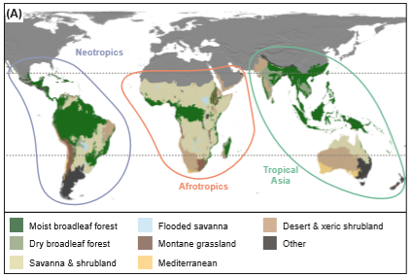
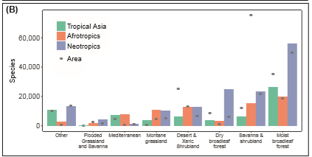
Understanding biodiversity
Earth 4–10 million species & more.
Latitudinal gradients.
Species richness differs among the tropical continents (similar environment) -> importance continental evolutionary history on global biodiversity.
(Zizka 2018)
Notes:
Figure 1 The major biomes in the Neotropics, Afrotropics and tropical Asia, and their area and raw species counts of ﬂowering plants. For the majority of biomes the species richness is highest in the Neotropics, a pattern especially prominent in forest biomes. Realms, biomes and biome area from Olson et al. (2001), species estimates from GBIF (2016). Species can occur in multiple areas. The grey dots show the relative area of each biome in each realm.

Slide 8
WHY ARE SOME PLACES MORE DIVERSE THAN OTHERS?
AKA: Latitudinal Gradients of Biodiversity

Slide 9
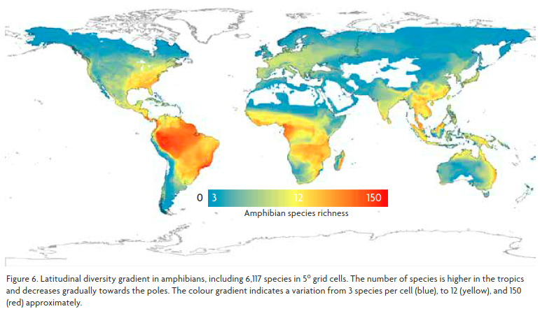
Notes:
Pyron and Wiens, 2013: https://royalsocietypublishing.org/doi/full/10.1098/rspb.2013.1622?url_ver=Z39.88-2003&rfr_id=ori:rid:crossref.org&rfr_dat=cr_pub%3dpubmed

Slide 10
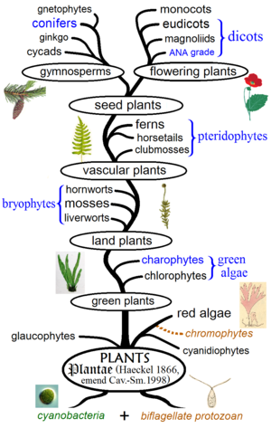
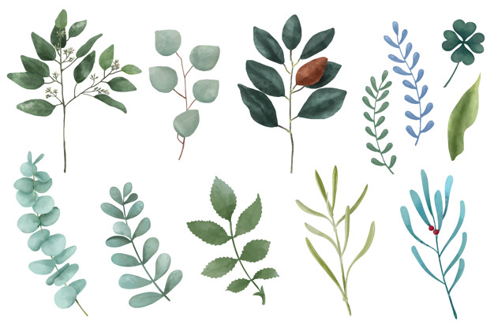
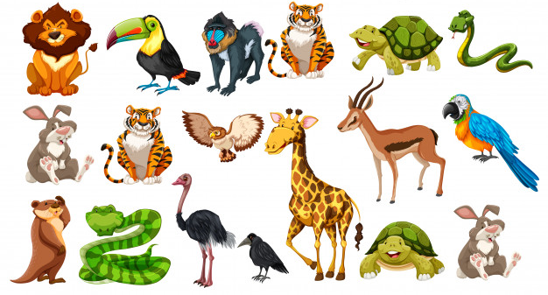
Latitudinal Gradients of Biodiversity
Overall biotic richness increases toward equatorial regions (underlying explanations still inconclusive).
In all major taxa and to all dimensions of biodiversity (i.e., taxonomic, functional, and phylogenetic).
Notes:
Antón-Pardo, 2018: https://www.researchgate.net/publication/326656888_The_map_of_biodiversity_From_local_to_global_scales

Slide 11
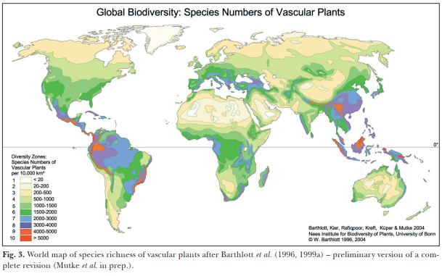
Notes:
MUTKE, J. & BARTHLOTT, W. 2005. Patterns of vascular plant diversity at continental to global scales. Biol. Skr. 55: 521-531. ISSN 0366-3612. ISBN 87-7304-304-4.
https://www.nees.uni-bonn.de/research-/systematics-evolution-ecology/biogeography-and-macroecology-biomaps/biomaps-pdf/mutke-j.-w.-barthlott-2005-patterns-of-vascular-plant-diversity-at-continental-to-global-scales.-biologiske-skrifter-55-521-537

Slide 12
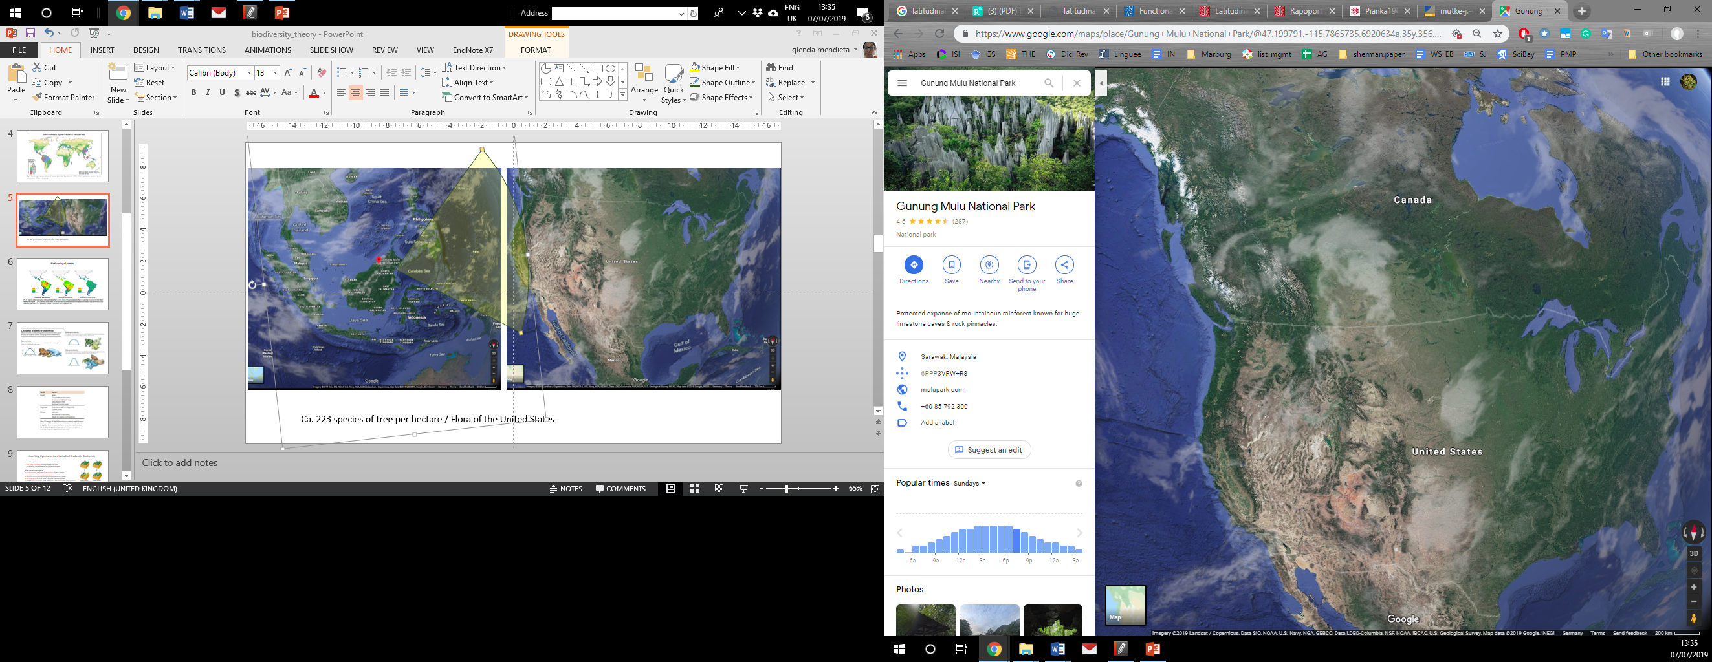
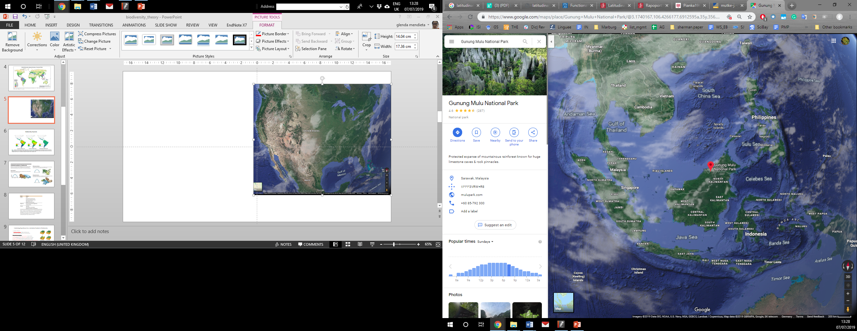
Ca. 223 species of tree per hectare; this can be compared with the entire tree flora of the United States & Canada (700 spp)
Small section of Amazonian flood plain 286 fish spp > than the whole Europe (ca. 215 fish spp)
Notes:
Sherratt, T.N. & D.M. Wikinson. 2009. Big questions in ecology and evolution. Oxford University Press.

Slide 13
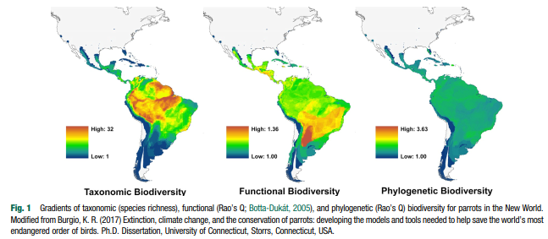
Biodiversity of parrots

Slide 14
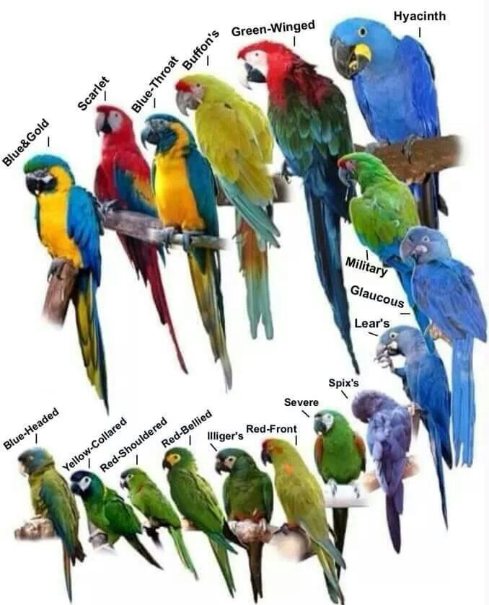
Biodiversity of parrots
Functional trait is deﬁned as any morphological, physiological, phenological, or behavioural characteristic of an individual.
Notes:
A functional trait is deﬁned as any morphological, physiological, phenological, or behavioural characteristic of an individual (Violle et al. 2007; Luck et al. 2012). For example, relevant traits for birds include body mass, bill length, clutch size (#eggs), foraging behaviour and habitat use. Promoting a diversity of traits– ‘functional diversity’ –is crucial for the maintenance of a range of ecosystem functions.

Slide 15
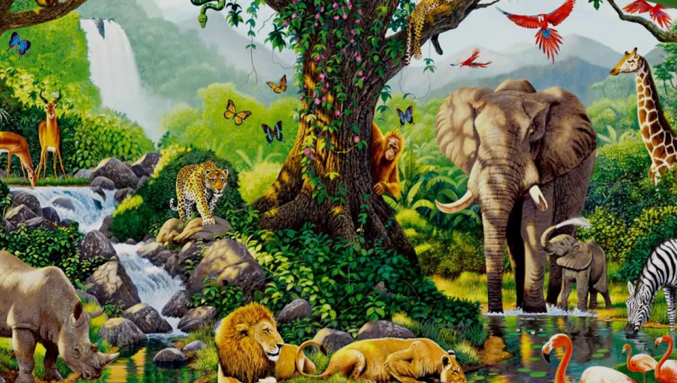
Understanding tropical biodiversity
Six main classes of explanation by Pianka (1966), since then some have been added:
These are generally classified into:
Null models, geometry instead of biology to explain tropical diversity
Historical explanations, geological past to explain present distributions
Ecological processes, operating today (ecological explanations)
Notes:
(Pianka 1966) http://biology.unm.edu/jhbrown/Documents/511Readings/Pianka1966.pdf
Sherratt, T.N. & D.M. Wikinson. 2009. Big questions in ecology and evolution. Oxford University Press.

Slide 16
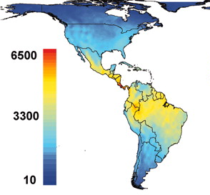
Understanding biodiversity
Processes
Patterns
Evolutionary biogeography
Speciation, extinction, migration
Species, genes, functions, bioregions
Silvestro et al (2011) BMC Evol Biol, Kreft & Jetz 2007, PNAS

Slide 17
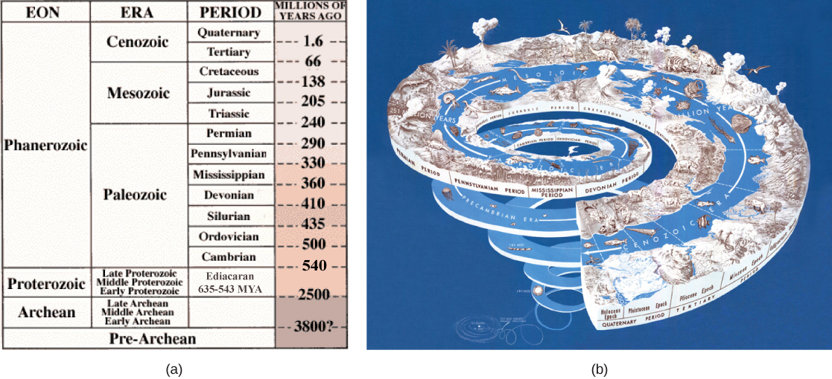
Biodiversity varies through time…

Slide 18
… and space
Barthlott et al. (2005)

Slide 19
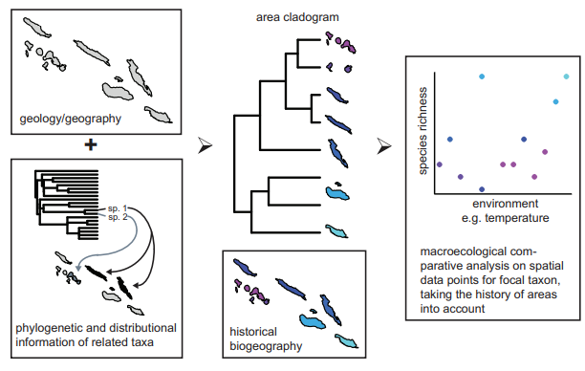
Integration of historical biogeography into macroecological research
Notes:
using area cladograms and comparative methods (Beck et al 2012)

Slide 20
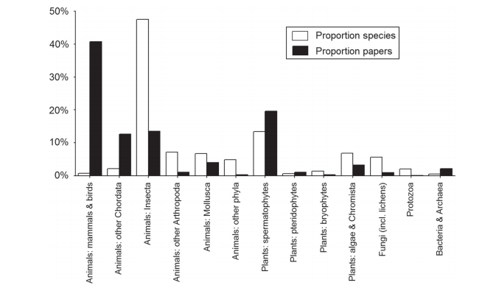
Distribution of macroecological papers
Notes:
using area cladograms and comparative methods (Beck et al 2012)

Slide 21
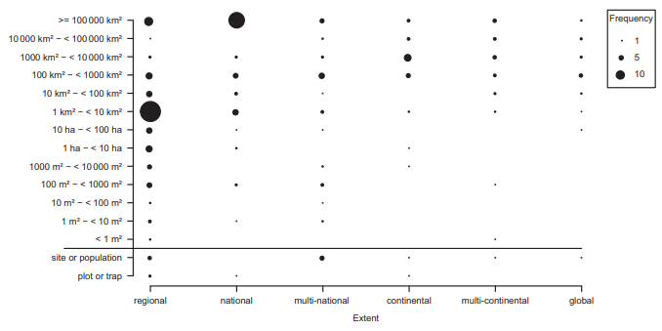
Extent and grain sizes used in macroecological studies
Notes:
using area cladograms and comparative methods (Beck et al 2012)

Slide 22
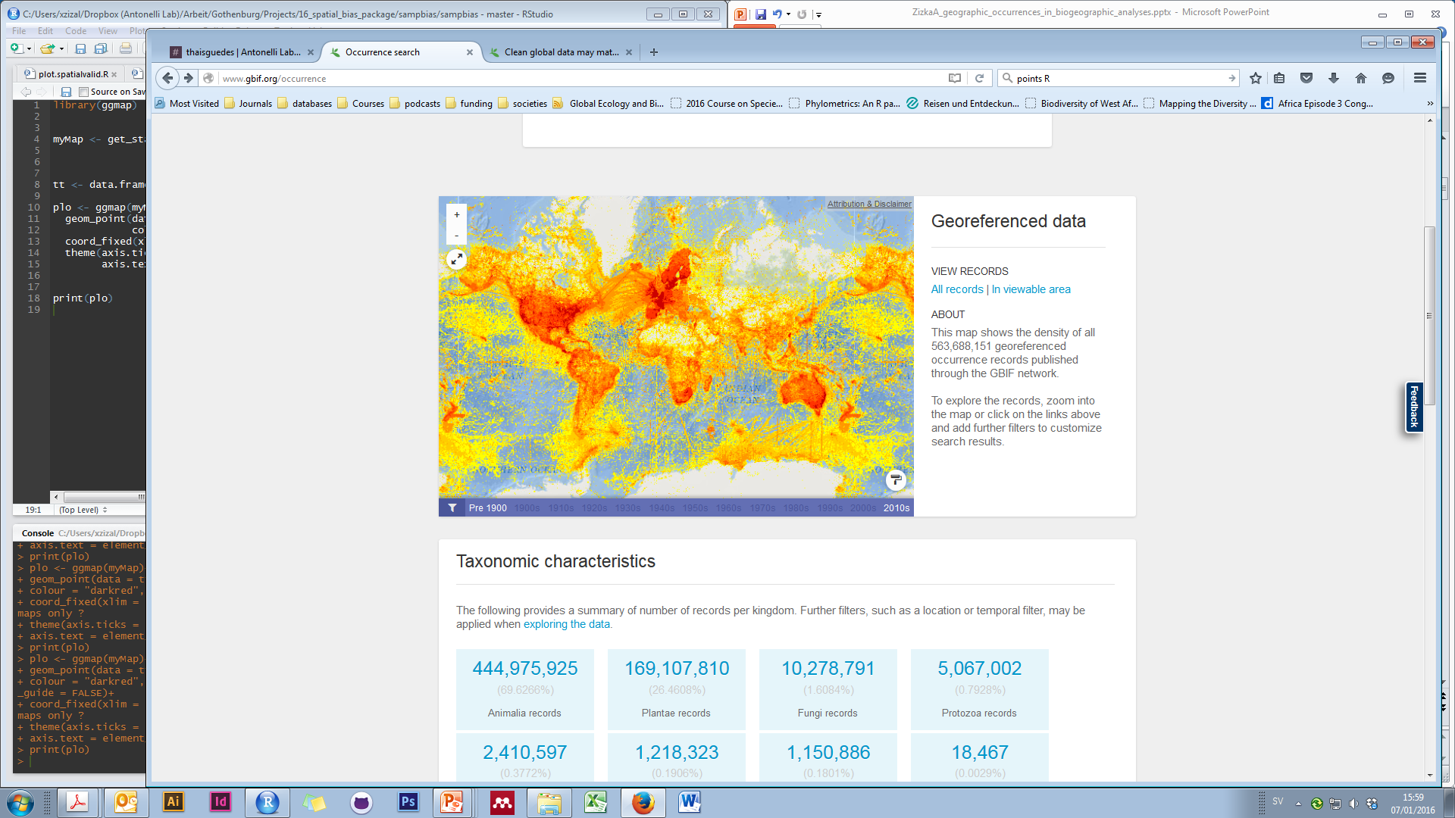
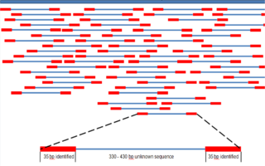
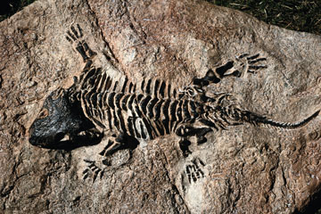
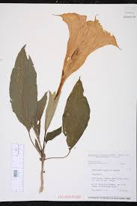
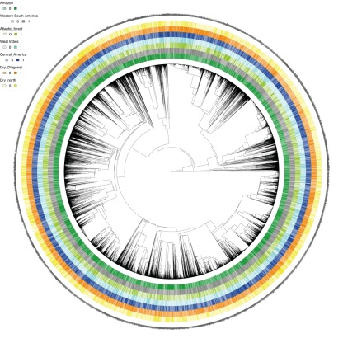
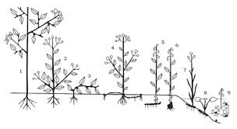
Main sources of biodiversity data
Distribution
DNA
Fossils
Traits
Taxonomy
Phylogenies

Slide 23
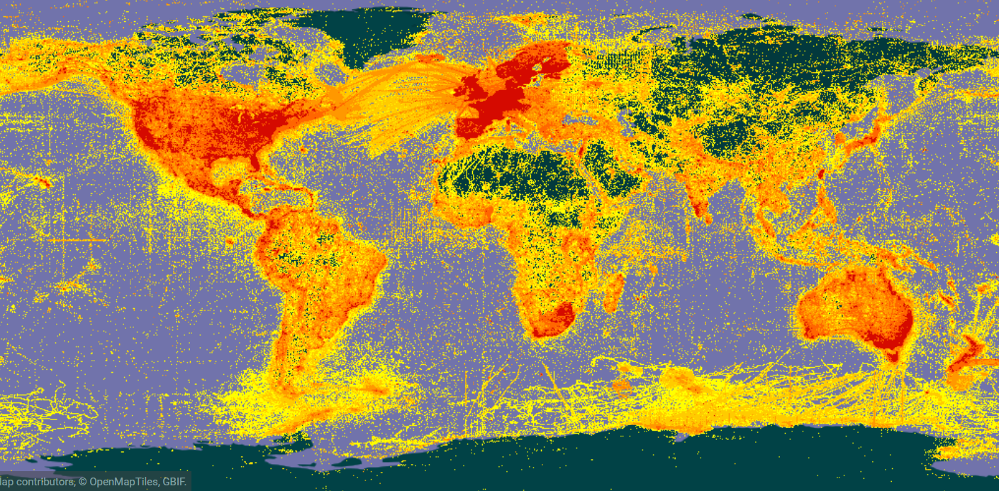

We have a lot of data…
Notes:
Who is familiar with GBIF? (make everyone familiar with, webpage)

Slide 24
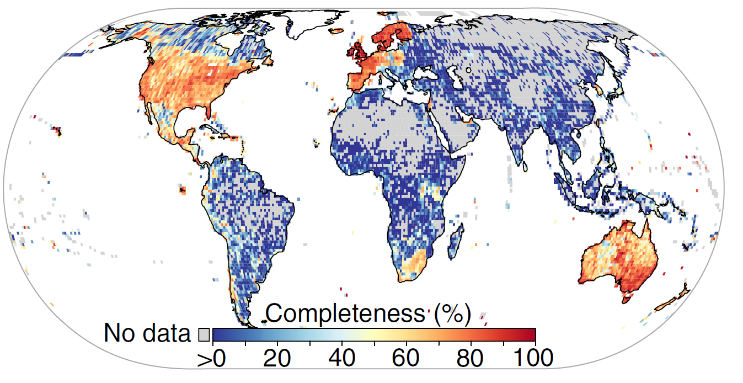
… but also lot of problems
Wallacean shortfall: “The geographic distribution of most species still poorly known.”
Meyer et al (2015) Nat. Comm.

Slide 25
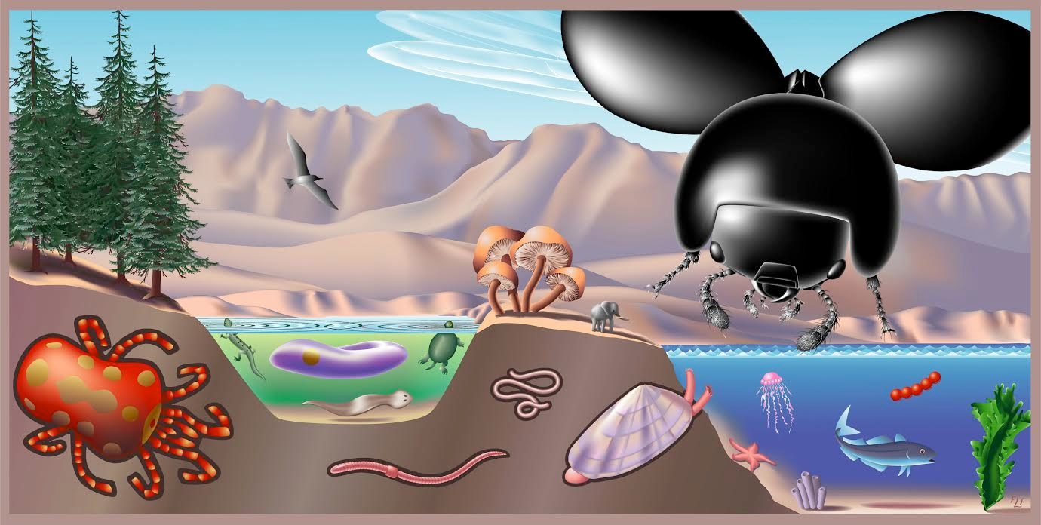
Key challenges:
Filling gaps
Dealing with biases and errors
“Species-scape”

Slide 26
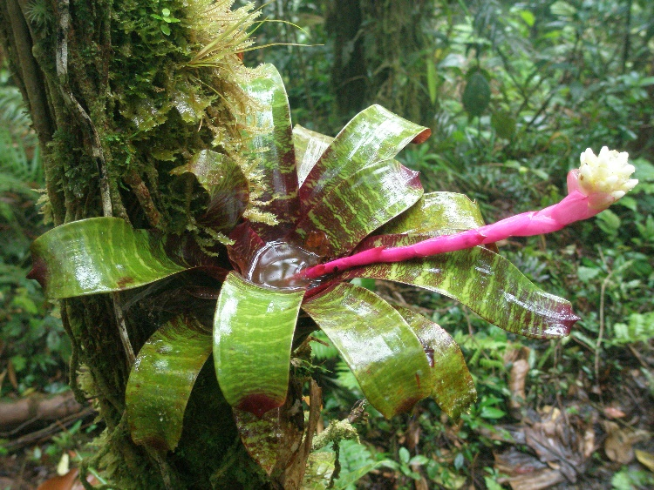
Space #I: Biodiversity patterns in the tropics
Species richness
Knowledge richness
The pineapple family (Bromeliaceae): A Neotropic radiation with c. 3,500 species

Slide 27
Space #I: Biodiversity patterns in the tropics
Scanned and cleaned > 780,000 occurrence records from databases and field collections for 16,582 taxa using CoordinateCleaner
Zizka et al. (in press), DDI

Slide 28
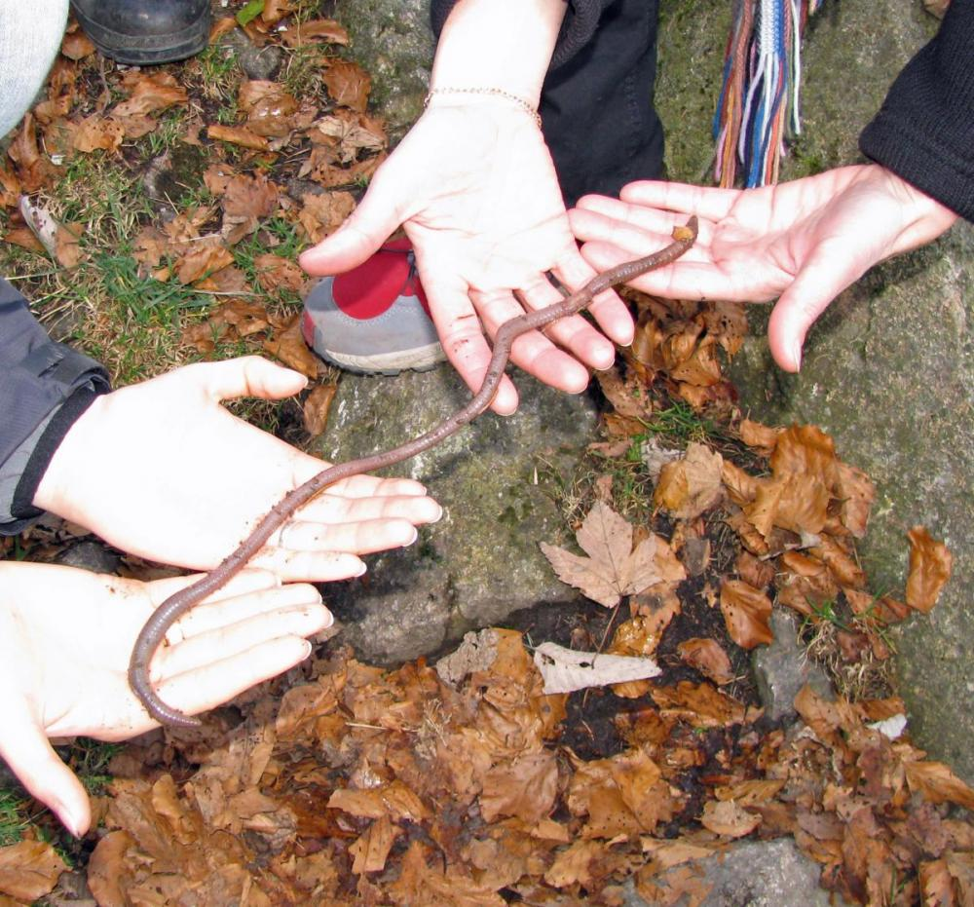
Space #I: Biodiversity patterns in the tropics
Species richness
Endemism
Threatened species
Zizka et al. (in press), DDI
Notes:
Badischer Riesenregenwurm, giant earthworm, a species of annelid. It is endemic to the upper-elevation spruce forests of Germany's Black Forest. Lumbricus badensis. Endemism is the ecological state of a species being unique to a defined geographic location, such as an island, nation, country or other defined zone, or habitat type; organisms that are indigenous to a place are not endemic to it if they are also found elsewhere.

Slide 29
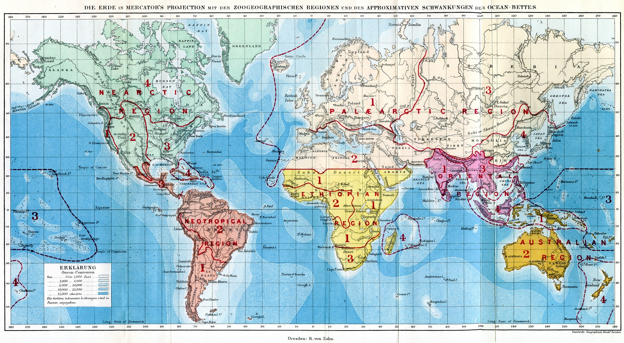
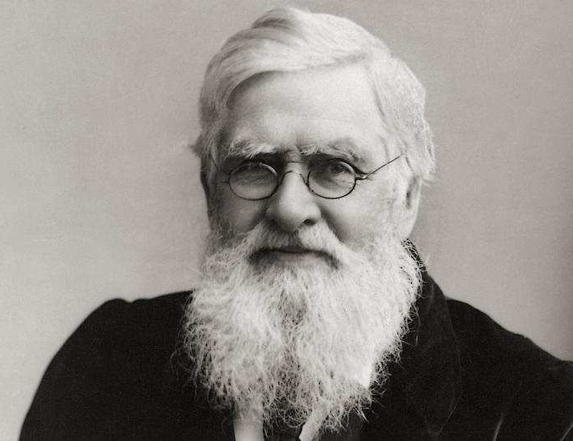
Space #2: Identifying and delimiting bioregions
Wallace (1876)

Slide 30
Space #2: Identifying and delimiting bioregions
Myers (2001), Antonelli (2009)
Notes:
https://academic.oup.com/bioscience/article/51/11/933/227116 (Olson 2011)

Slide 31
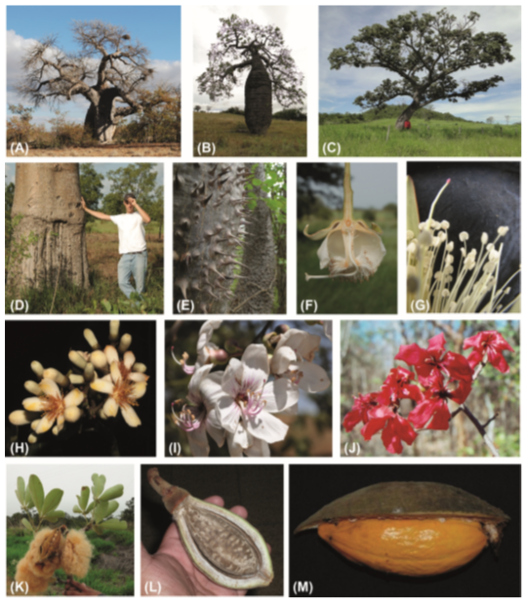
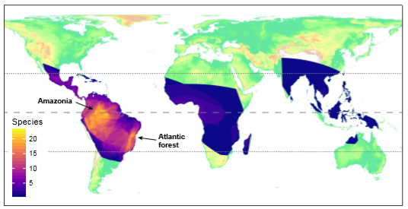
Space #2: Identifying and delimiting bioregions
Notes:
Figure7 The global distribution of Bombacoideae. The group is widespread across all three tropical realms (Fig. 1), but the Neotropics are most diverse, in particular Amazonia and the Atlantic forest in Eastern Brazil. Warmer colours indicate more species, the lines show the equator and the Tropics of Cancer (23.4◦ N) and Capricorn (23.4◦ S).

Slide 32
Space #2: Identifying and delimiting bioregions
By “expert opinion”
By similarity
Morrone (2014), Zootaxa

Slide 33
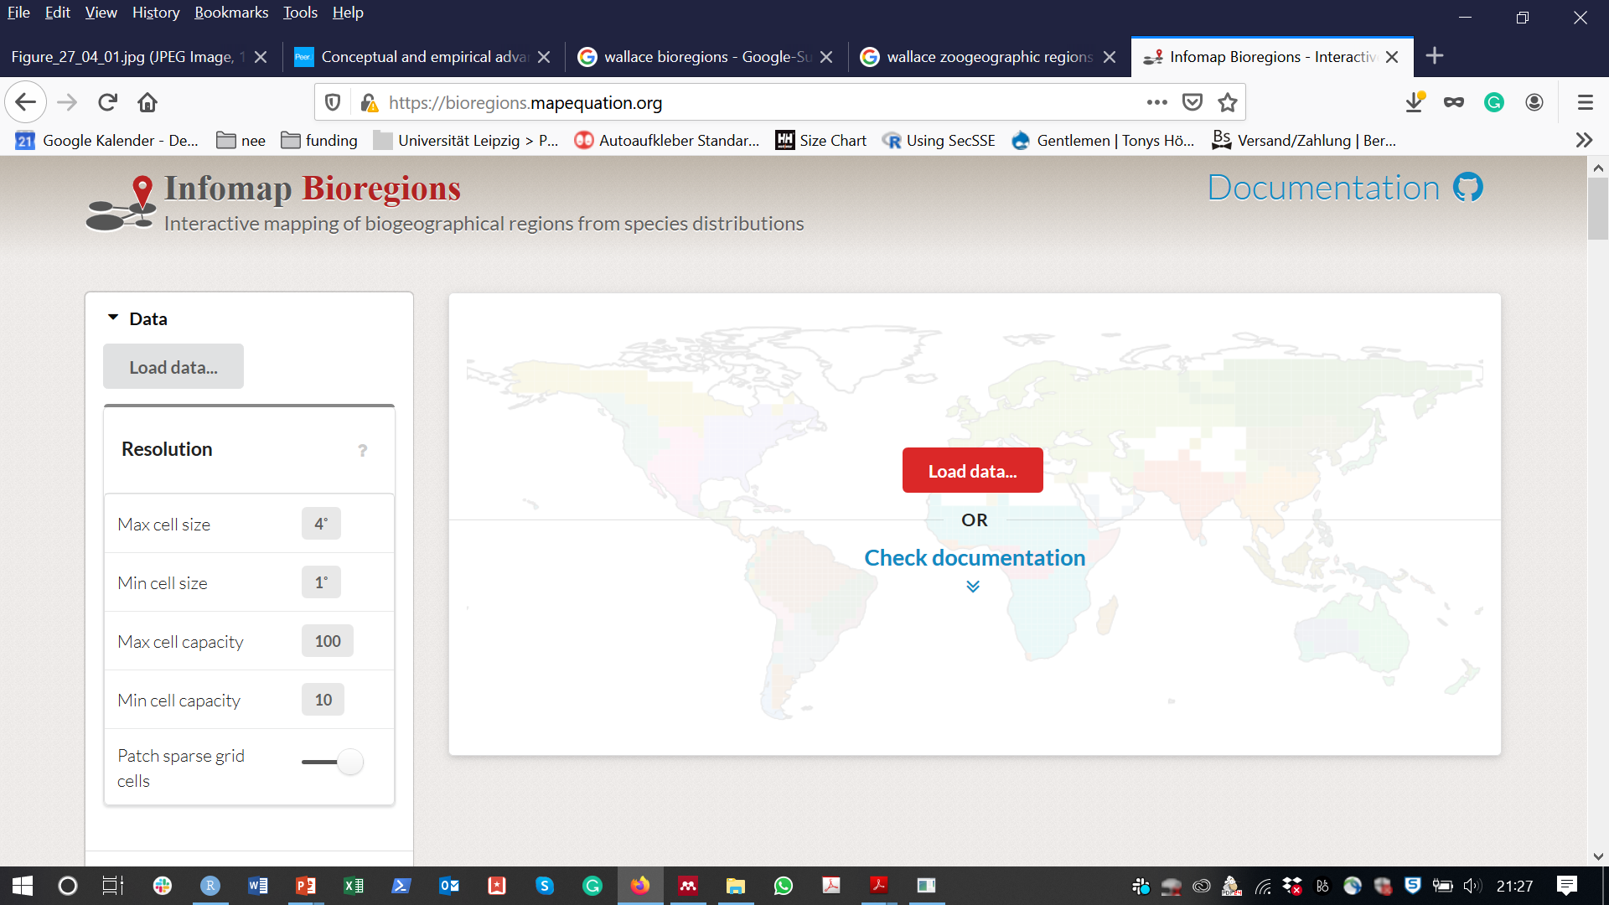

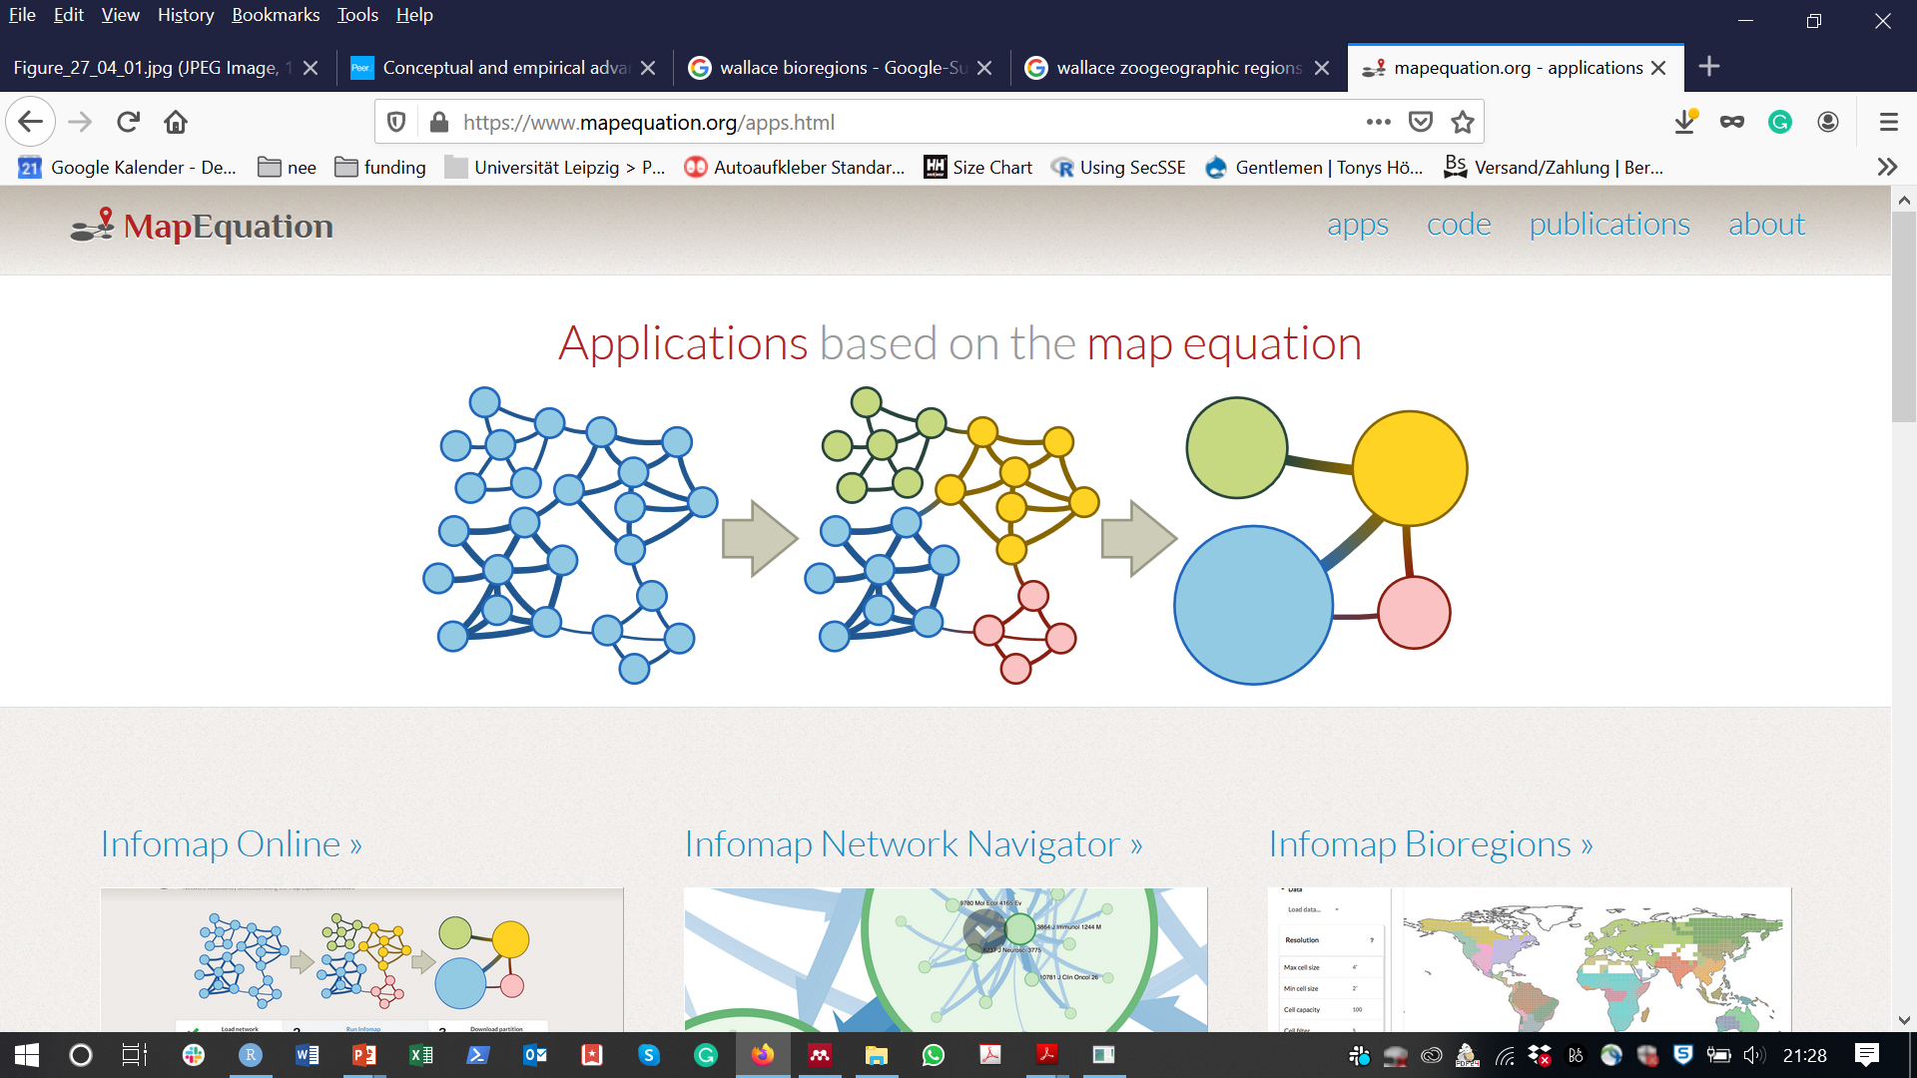
Space #2: Identifying and delimiting bioregions
Vilhena & Antonelli (2015) Nat Comm
Edler et al. (2017) Syst Biol
Zizka et al (2018) Ecography

Slide 34
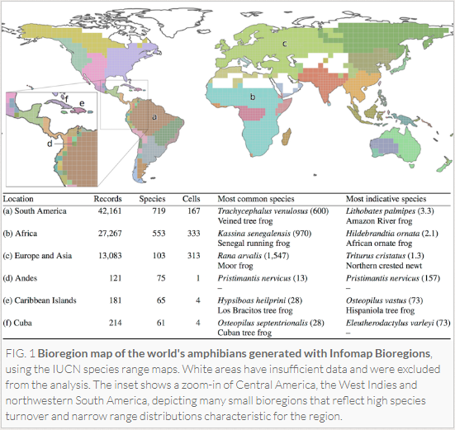
Space #2: Identifying and delimiting bioregions
Notes:
https://www.mapequation.org/bioregions/

Slide 35
Space #2: Identifying and delimiting bioregions
Antonelli (2017), Nat Eco Evol

Slide 36
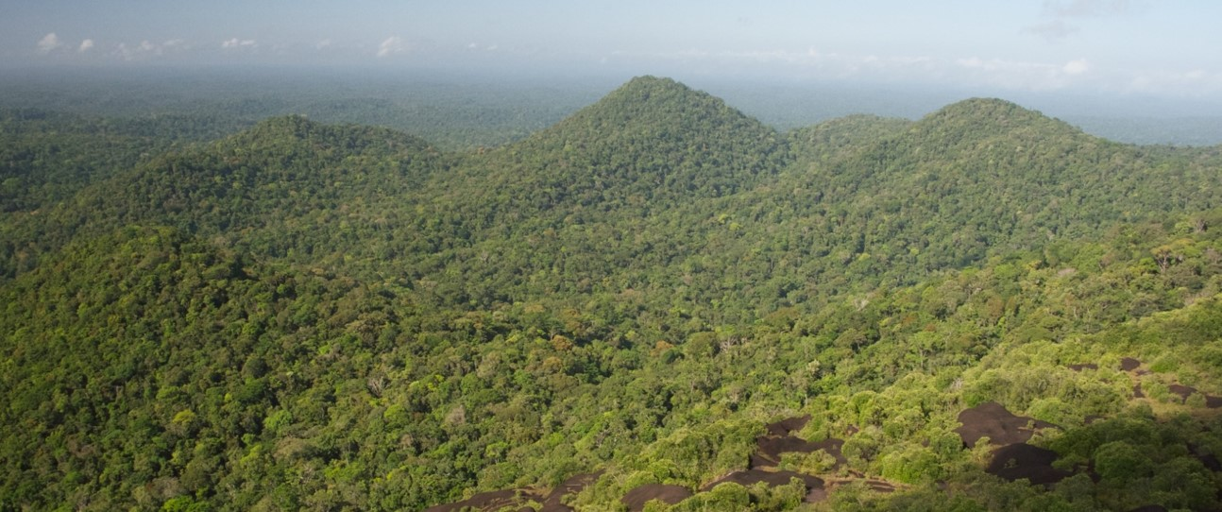
Space #3: The distribution of rare species

Slide 37
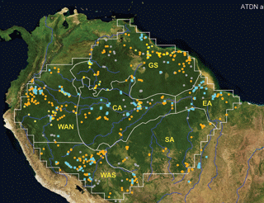
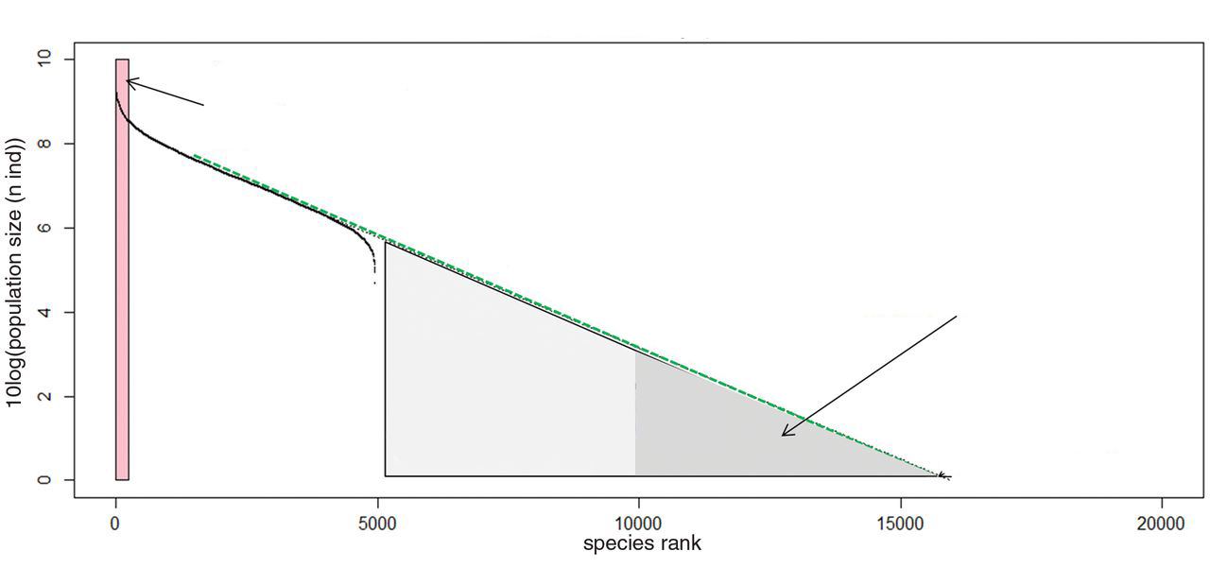
Space #3: The distribution of rare species
Most species within the Amazonian rainforest have small populations
10
Hyper dominants
8
6
Number of Individuals [log10]
Population < 1000 individuals
4
2
0
0
5000
10000
15000
20000
Species rank
Modified after ter Steege et al. (2013) Science
Notes:
Rare species are a puzzling element of biodiversity, because it is often unclear how they can avoid extinction and maintain gene flow, and because they are of special concern for conservation. Interestingly, it has recently been proposed, that many of the tree species in the Amazonian rainforest are actually rare. Here you can see an estimate of the population size of all Amazonian tree species (explain graph, ten thousand million), which shows that there are about only 200 hyperdominant species with large population size representing the majority of individuals in Amazonia, whereas one third of the species comprises less than 1000 individuals. However, virtually nothing was known of the geographic distribution of these species.

Slide 38
Space #3: The distribution of rare species
Area: Amazonia
Data: 1.5 M occurrence records from 67,000 species
Record cleaning using CoordinateCleaner
Species Assignment using SpeciesGeoCoder
Zizka et al. (2018), Ecography

Slide 39
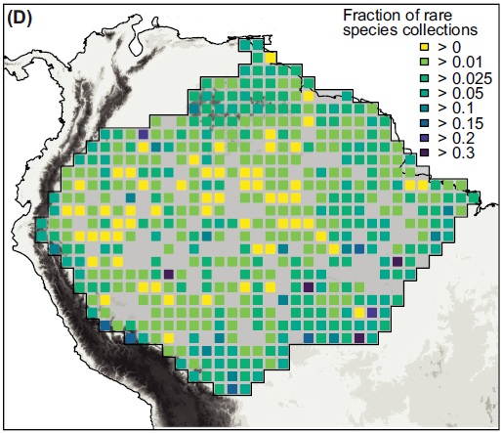
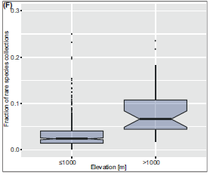
Space #3: The distribution of rare species
“Rare species” are more common in the highlands
Zizka et al. (2018), Ecography
Notes:
https://onlinelibrary.wiley.com/doi/full/10.1111/ecog.02192

Slide 40
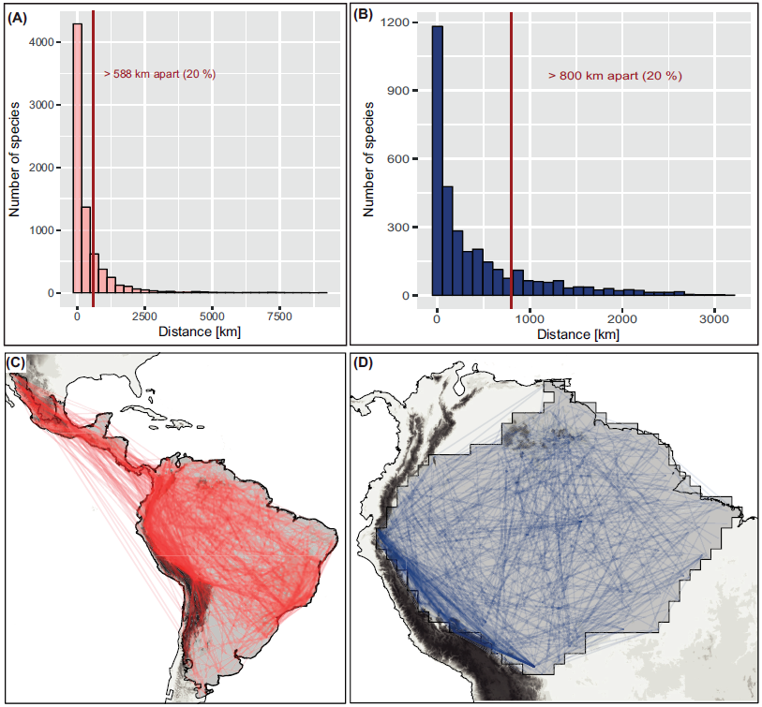
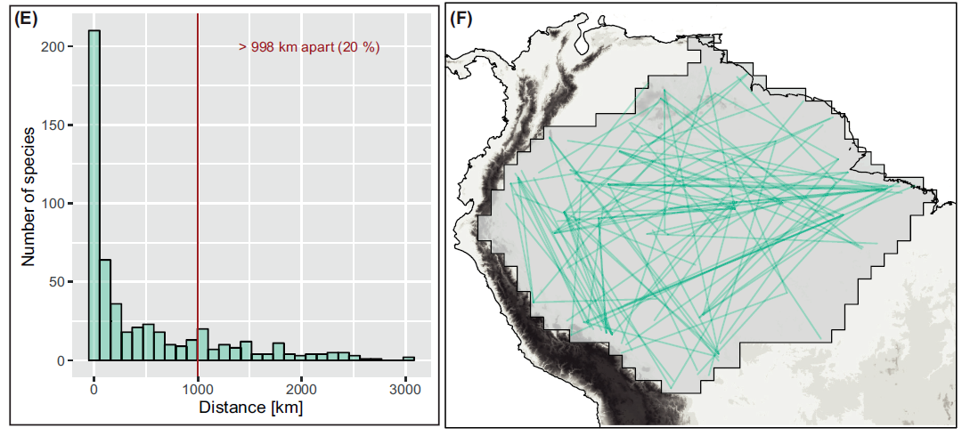
Space #3: The distribution of rare species
> 800 km apart (20%)
> 998 km apart (20%)
Zizka et al. (2018), Ecography
Notes:
considerable proportion of rare plant species have surprisingly large distribution ranges, and that collections of rare species across most of the lowland Neotropics, and in particular in Amazonia, show no clear directionality. The second record of many rare species may be found virtually anywhere, urging the need for intensifying and broadening biological sampling.

Slide 41
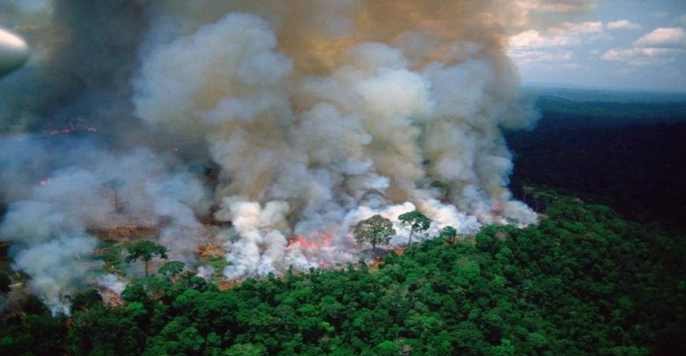
Space #4: Speeding up conservation assessments

Slide 42
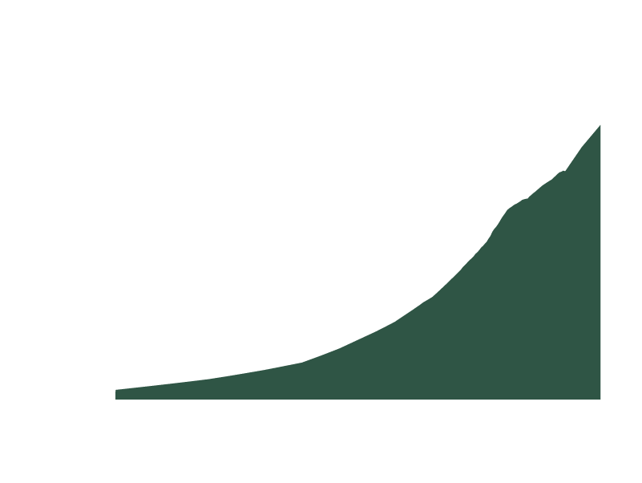
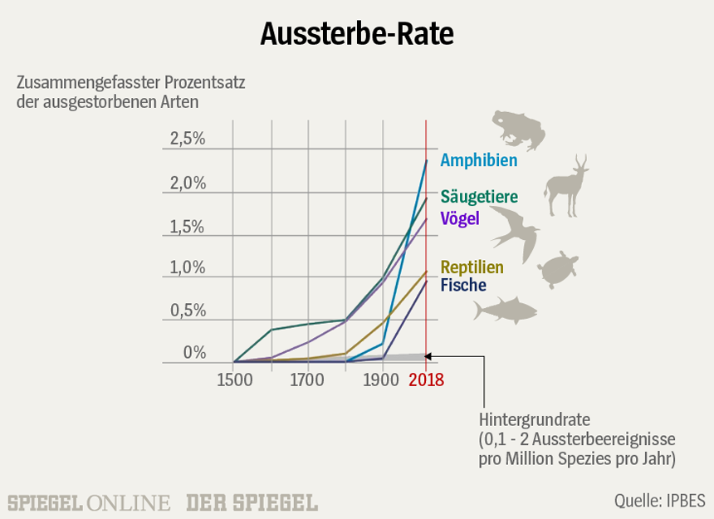
Space #4: Speeding up conservation assessments
WWF 2018, IPBES 2019

Slide 43
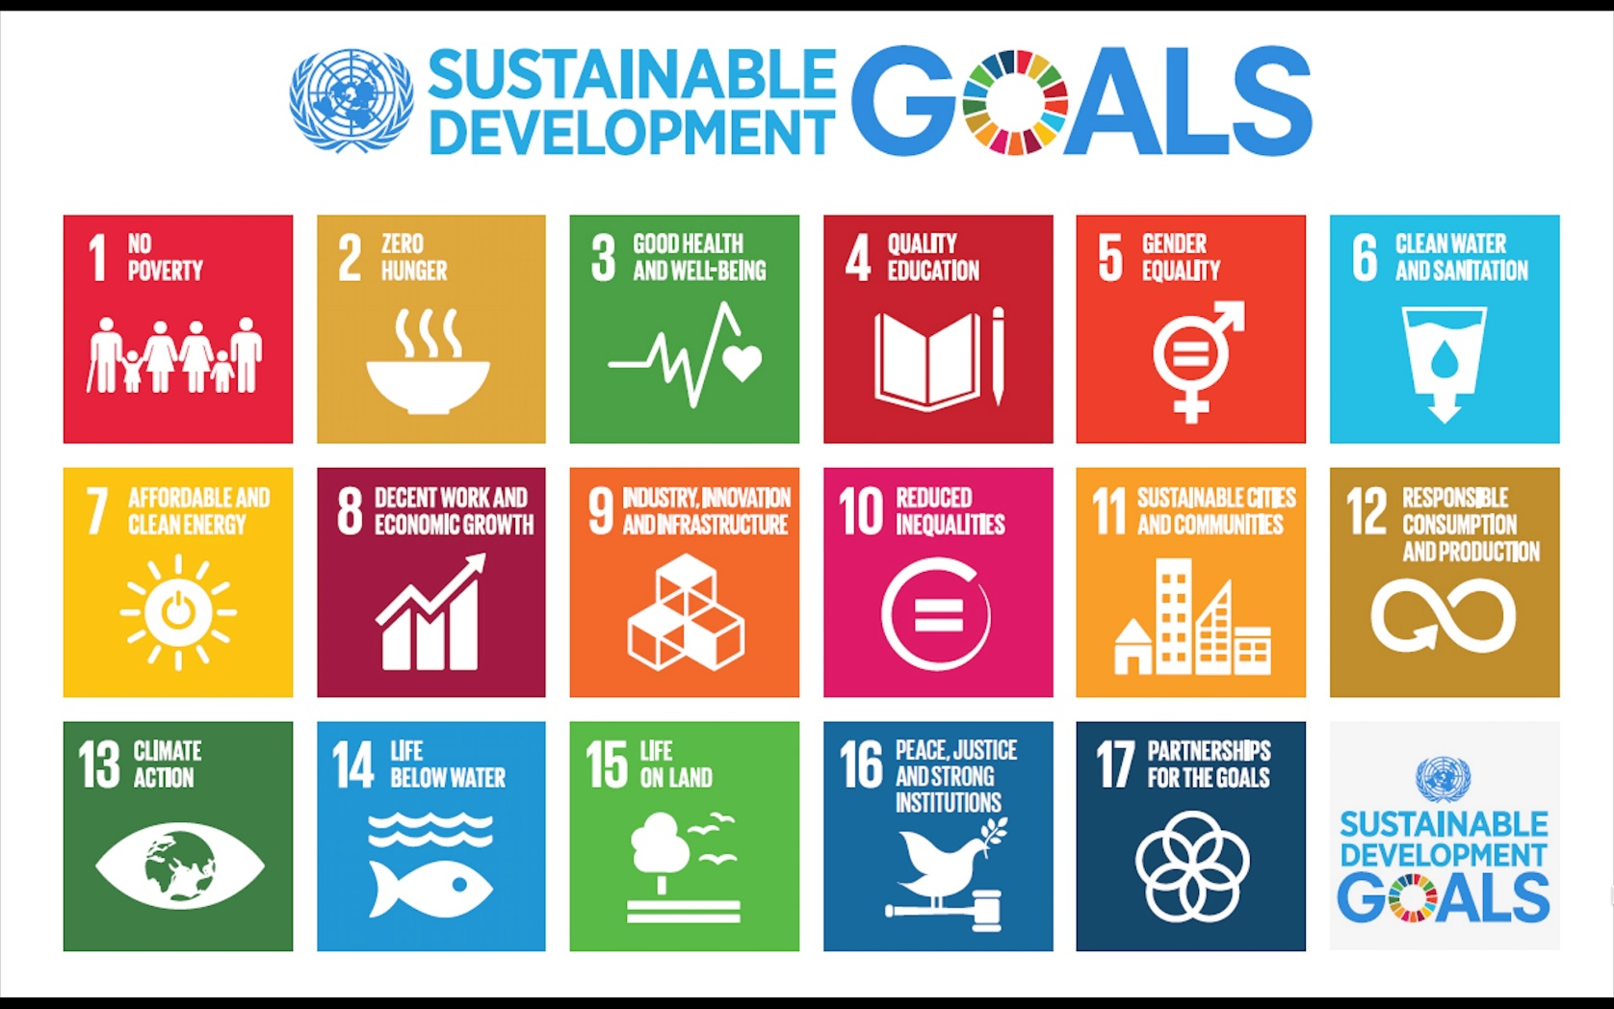
Space #4: Speeding up conservation assessments

Slide 44




Space #4: Speeding up conservation assessments
Geographic range, Population size, Population trend, Threats
Notes:
https://www.iucnredlist.org/, International Union for Conservation of Nature: The Red List of Threatened Species, founded in 1964, is the world's most comprehensive inventory of the global conservation status of biological species. It uses a set of criteria to evaluate the extinction risk of thousands of species and subspecies.

Slide 45

Space #4: Speeding up conservation assessments
High quality & high impact
Time & data intensive
Data from
www.iucnredlist.org
Notes:
Which are related to the evaluation process. Species are evaluated based on expert knowledge, informed by data (on the five indicator criteria). The first problem is, that due to the expert based process, the assessments are somewhat subjective and difficult to reproduce. And the second problem is that the process is very data intense, which leads to a severe taxonomic bias. That is exemplified by this graph that shows the percentage of species evaluated for red lists in different taxonomic groups. As you can see all of birds and mammals and most of vertebrate species are evaluated, but few invertebrates and almost no microbes. Or
IUCN red lists are based on expert assessment
Mostly available for well studied groups and regions

Slide 46
Space #4: Speeding up conservation assessments
How to speed up conservation assessments?

Slide 47

Space #4: Speeding up conservation assessments
GBIF > 1,300,000,000 records
Notes:
And because it is his 250th birthday this year, I say Humboldt to the rescue. And with him all the scientists that have been and are collecting scientific specimens for the last 300 years. Today, georeferenced occurrence data from more than 1.3 billion of these speciesmens are publicly available via the global biodiversity Information facility, and provide a fantastic resource on species geographic distribution.

Slide 48
Space #4: Speeding up conservation assessments
Approximation of IUCN assessment based on geographic range
Species with a small range and low occupancy are considered more threatened
Quick, cheap, easy
Occurrence records
Extent of Occurrence (EOO)
Area of Occupancy (AOO)
But, how accurate?

Slide 49




Space #4: Speeding up conservation assessments
AA for 14,177 orchid species (> 1 million of records)
Comparison with > 900 full IUCN assessments
Automated conservation assessment ConR

Slide 50
Space #4: Speeding up conservation assessments

Slide 51
Space #4: Speeding up conservation assessments
29
71
1
40
61
101
Correctly classified 76% of species as possibly threatened or not threatened
Zizka et al., in review, material non reproducible

Slide 52
Space #4: Speeding up conservation assessments
Zizka et al., in review, material non reproducible
Notes:
This can be done with R

Slide 53

http://geocat.kew.org/

Slide 54

Home Work

Slide 55

Time #1: Biome and bioregion connectivity through time
Species A
Species B
Bioregion shift
Species C

Slide 56
Time #1: Biome and bioregion connectivity through time
Antonelli*, Zizka*, Carvallho* et al. (2018), PNAS

Slide 57
Time #1: Biome and bioregion connectivity through time
4,450 species, 1,3 million occurrences, published phylogenies
Area assignment using SpeciesGeoCoder (Topel, Zizka, et al. 2017, Syst Biol)
Range shift estimated in BioGeoBEARS (Matzke et al. 2013 MEE)

Slide 58


Time #1: Biome and bioregion connectivity through time
Substantial interchange
Amazonia is in the center
Antonelli*, Zizka*, Carvallho* et al. (2018), PNAS

Slide 59
Time #1: Biome and bioregion connectivity through time
Large similarities across taxonomic groups
Antonelli*, Zizka*, Carvallho* et al. (2018), PNAS

Slide 60


Time #1: Biome and bioregion connectivity through time
Tens of millions of years
Diversity & area best predictors
Antonelli*, Zizka*, Carvallho* et al. (2018), PNAS

Slide 61
Time #1: Biome and bioregion connectivity through time

Slide 62



Time #1: Biome and bioregion connectivity through time
Bombacoideae
20,000 occurrence records, 104 species, 5 genes
Evergreen rainforest and seasonally dry biomes
Time constraint DEC model in BioGeoBEARS
www.blueplanetbiomes.org

Slide 63


Time #1: Biome and bioregion connectivity through time
Many shifts among biomes
More from rainforest to dry biomes than vice versa

Slide 64

Time #1: Biome and bioregion connectivity through time
Constant shifts through the Miocene

